Slide 1

STUDENT HUB
Ashokkumar Bhati – 24207001
Piyush Ghadge – 24207005
Krish Patil - 24207006
Muhmmad Momin - 24207008
Project Guide
Prof. Richa Singh

Slide 2
Contents
Introduction
Objectives
Scope
Features / Functionality
Project Outcomes
Technology Stack
Block Diagram if applicable

Slide 3
1. Introduction
Problem Identified :
Manual Data Entry Issues – Entering student data manually is time-consuming and prone to human errors.
Delayed Result Processing – Traditional result processing methods take time, leading to delays in student performance evaluation.
Solutions Provided :
Automated Data Import – Reduces manual data entry by fetching student data from databases, spreadsheets, or APIs.
Centralized Student Records – Provides a single platform to store and manage student data efficiently.
Fast & Accurate Result Processing – Ensures quick calculation and display of student results with minimal errors.

Slide 4
2. Objectives
To automate student result processing by reducing manual effort through automated calculations and data imports.
To provide a centralized student database for structured and easily accessible record management.
To develop an interactive GUI that enhances user experience for teachers and administrators.
To enable real-time student performance analysis using graphical reports and insights for academic tracking.

Slide 5
3. Scope
Can be useful to:
Teachers – To manage student records, analyze performance, and generate reports in school.
Parents – To track their child's academic progress and receive important updates.
Administrators – To handle student data, manage result processing, and ensure data security.
Can be applied in – Schools, Colleges,etc.

Slide 6
4. Feature /Functionality
Upload & Process CSV – Allows users to upload student data in CSV format and process it automatically. Search Student – Enables quick searching of student records based on name, ID, or other filters. Sort Students – Provides sorting options to arrange student data based on different criteria (e.g., marks, name, rank). Top Performers – Displays a list of the highest-scoring students based on academic performance. Visualize Data – Generates graphs and charts to analyze student performance trends. Save Processed Data – Allows users to save the processed student data for future reference or reporting. View All Results – Displays the complete list of student results in an organized format.

Slide 7
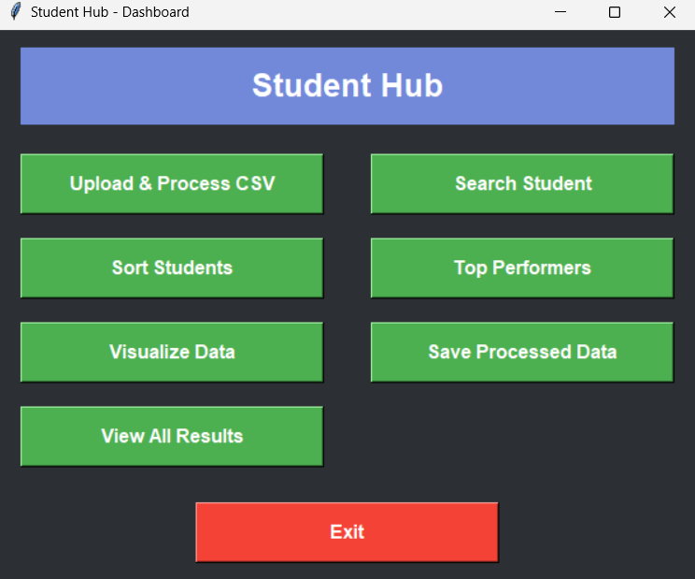
5. Outcome of Project

Slide 8
6. Technology Stack
Python
Tkinter
Pandas
Matplotlib
MySql

Slide 9
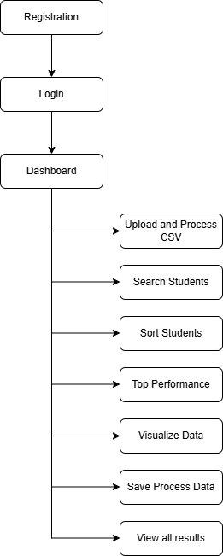
7. Block Diagram

Slide 10
Thank You...!!

